Slide 1
Normalization
Abylkassymova A.B.

Slide 2
Overview
Normalisation is a process undertaken to minimise data redundancy and produce efficient table structures.
It is a formal technique for analysing individual relations and was introduced by (E.F. Codd, 1970).
A set of steps is followed to ensure that the relation is transformed through a number of states into a form which is generally referred to as ‘normalised’.

Slide 3
States
At the logical design stage relations can be in one of four states, depending on whether certain conditions are satisfied.
These states are:
Un-normalised (UNF),
1stNormal Form (1NF),
2ndNormal Form (2NF),
3rdNormal Form (3NF).
Each state imposes further conditions on those required by the previous one.
The process of normalisation is used to produce a logical design which will lead to an efficient and effective database.

Slide 4
Why do we need normalization?
The aim is to avoid in the database:
unnecessary wastage of storage space
data redundancy (or data duplication – data (attributes) held in more than one place).
to compromise the integrity of the system.
Not to result in out of date information being used
If the ERD has been produced correctly, the resulting logical design will already be normalised to some
extent. In this case, the normalisation process is used to check the definitions of the relations and, if
necessary, refine them

Slide 5
Un-normalised form (UNF)
An un-normalised table can be defined as having any of the following issues:
there are repeating groups (of attribute names)
the attribute values are not atomic (single)
there are “embedded tables”
To start the process you have to identify whether the data is in un-normalised form.

Slide 6

Example (the invoice)

Slide 7
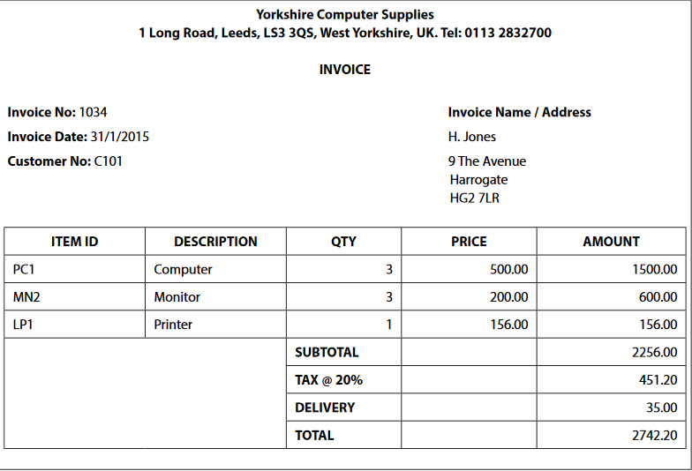
Step 1
To identify a list of attributes including an identifying attribute from the invoice that you want to hold within the database system:

Slide 8
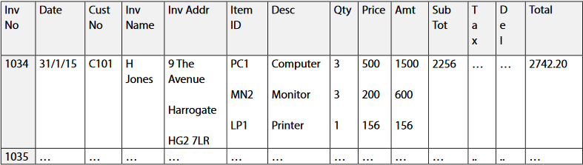
Step 2
The INVOICE table created from the attributes identified shows that for the following columns Item_ID, Desc, Qty, Price and Amount
It would not be appropriate to implement this table within
the database as it would prove difficult to extract the individual invoice items from it.
The data is not atomic – the cells contain more than one attribute value.

Slide 9
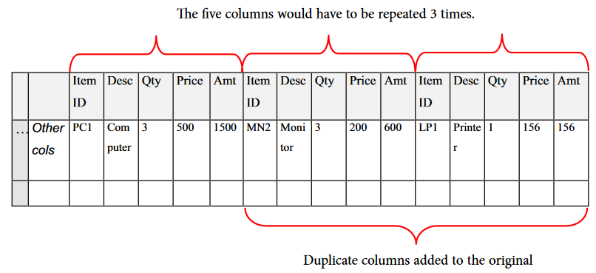
Step 3
In order to remove the embedded table it would be possible to redesign the table with repeating groups of attributes. The data could be rearranged by moving all the groups of invoice item data together in one long row:

Slide 10
Step 4
If this approach was adopted you would need to decide on the maximum number of invoice items per invoice.
However, if a large number was chosen the cells would often be left empty because not all invoices would have the maximum number of items, thus wasting storage space.
This also makes searching for data more complicated and if there was a need in future to increase the number of repeating groups, the table structure would need altering.
Having considered the issues for this example you can now see that it is in an un-normalised state and so will need normalising to avoid these issues

Slide 11
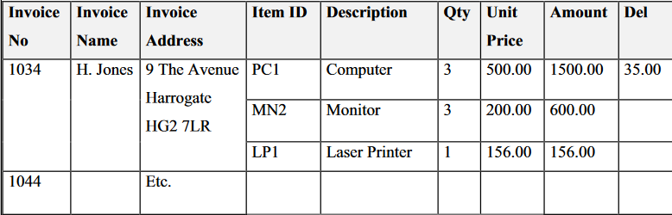
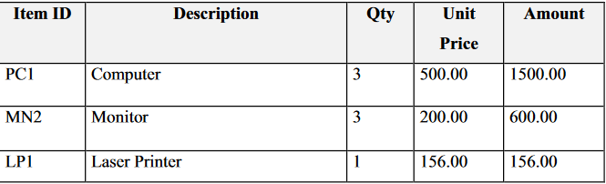
Exercise
In the invoice table below can you identify the embedded table?
Answer 1

Slide 12
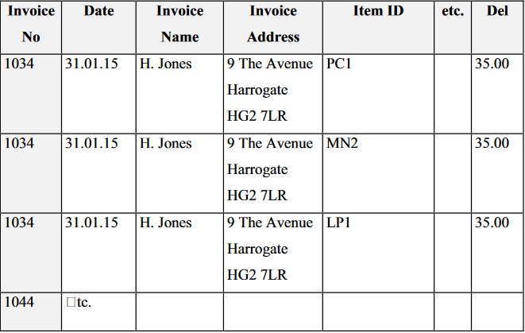
Exercise
It might be considered that a way round the problem would be to design the table in the following way:
The amended table should not be allowed as all the non-item columns Invoice_no, date, Invoice_Address,
Sub total, Tax, Delivery and Total would be repeated for each item, a very wasteful situation.
Can you see why this should not be allowed?

Slide 13
First Normal Form (1NF)
First Normal Form
A relation is in First Normal Form if all attributes are functionally dependent on the primary key.
In other words, for each value of the primary key there is only one value for each attribute in the relation.
Or, put simply, if you entered a Student_ID to search the database you would expect it to return just one set of student attributes.

Slide 14
How to do?
To convert a table to First Normal Form, multiple values or repeating groups of attributes must be removed to form another relation. To do this the following steps are carried out:
1. Identify the primary key for the relation (you may have to invent one)
2. Identify the repeating group or groups
3. Remove the repeating group completely from the original relation and place it in a newly- created relation
4. Ensure the relations are linked by putting the primary key of the original relation into the new one as a foreign key
5. Define a primary key for the new relation. This usually consists of two attributes, one of which is the Foreign Key, but there could be more than two.

Slide 15
Steps
To convert to First Normal Form, start with the original un-normalised list of attributes and identify a unique identifier for the whole list of attributes. This becomes the primary key; in this example it is Invoice_No;
The next step is to look for any repeating groups of attributes. In this example each group of ‘invoice items’ will be repeated for each item being invoiced. The repeating group consists of Item_ID, Description, Qty, Price and Amount and is shown in ( ) in the list of attributes. The repeating group is removed from the original group and placed in another relation.

Slide 16
Exceptions
In some situations there may be no obvious unique identifier attribute(s). In these cases you can invent an artificial identifier to act as the primary key, e.g. for a list of student details you could choose Student_ID.
If you find more than one repeating group of attributes, each group must be placed separately in its own relation.

Slide 17

Further look
You can now see how the original list of attributes has been broken down into two separate lists;
Therefore a foreign key needs to be identified for the new relation;
This will be the primary key of the original relation Invoice_No.
A foreign key is needed otherwise there will be no way of linking the new relation with the original one!

Slide 18
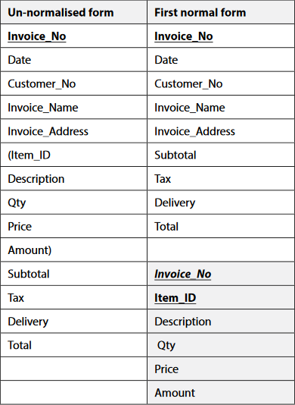
Finally!
ensure that the new relation is assigned a primary key.
a compound key

Slide 19
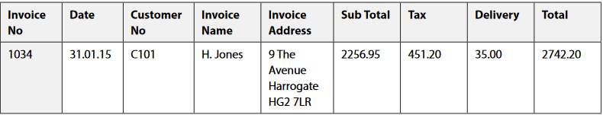
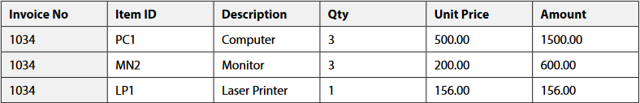
Resulting tables
INVOICE
INVOICE_ITEM

Slide 20
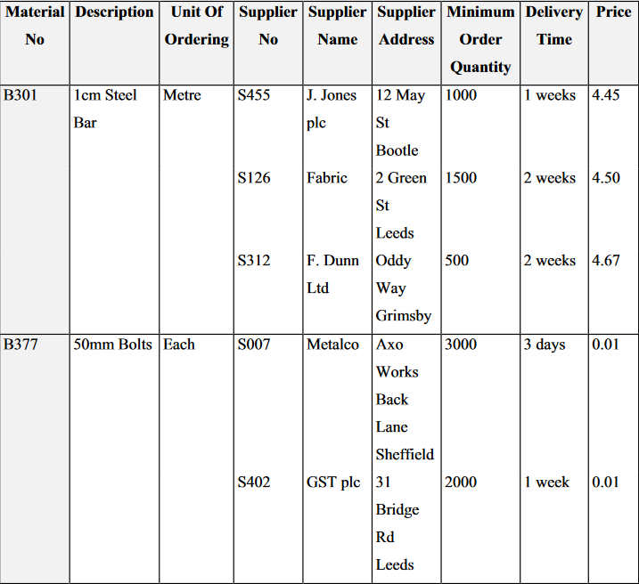
Exercise
A manufacturer obtains materials from a number of different suppliers which are used to make up products. The
information about the suppliers and what they can supply is shown here.

Slide 21
Tasks
Outline an embedded table. Give an appropriate name.
Mark the column range for the embedded table(s) in the new table above.
Feedback: MATERIAL table

Slide 22
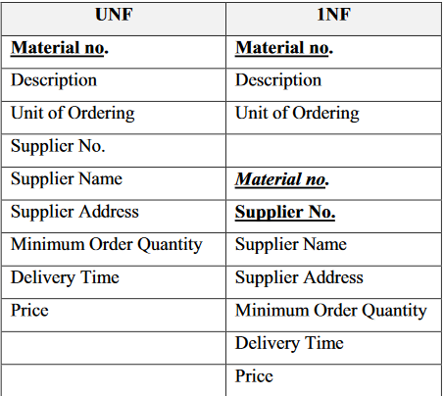
Tasks
c)List all the attributes in tabular form (UNF).
d) Convert the data from UNF to 1NF.

Slide 23

Tasks
e) Draw the conceptual data model (ERD) for the two resulting relations.
Feedback:

Slide 24
Second Normal Form (2NF)
A relation is in Second Normal Form if –
It is already in 1NF;
All non-key attributes are fully functionally dependent on the whole key;

Slide 25
Conversion from 1NF to 2NF
This conversion only applies to relations that have a compound key. i.e. any relation with a simple (single attribute) key is already in 2NF, if it is already in 1NF.
The process involves checking whether or not there are attributes that depend on only one part of the compound key.
To do this, follow the steps below:
1. Identify attributes with partial key dependencies
2. Remove the attributes with partial key dependencies into a new relation
3. Make the part key they are dependent on the primary key for the new relation
Do not forget to ensure that the original relation retains its compound key

Slide 26
Let us take a look ;)
Consider the INVOICE_ITEM relation example which is in 1NF but is not in 2NF.
You are not interested in the INVOICE relation because its primary key is a single attribute, so in effect is already in 2NF.
So, that just leaves the INVOICE_ITEM relation.
The compound primary key for this relation consists of the Invoice_Noand Item_ID.
So you need to determine which, if any, of the non-key attributes are dependent on only part of this key.

Slide 27
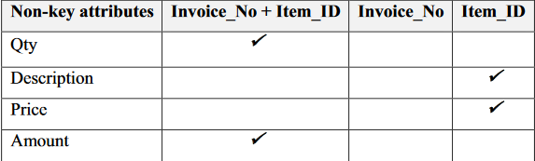
The following table shows the dependencies:
You can see that the Description and Price attributes only depend on the Item_ID part of the compound key and so need to be removed to a separate relation.

Slide 28
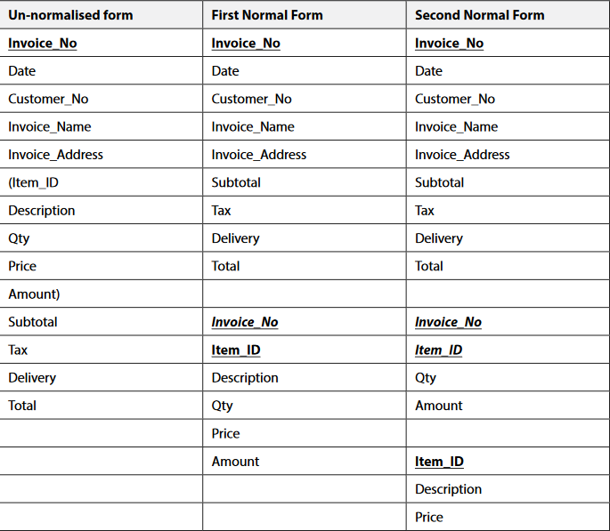
Continuing the conversion using the template will produce the following results:

Slide 29
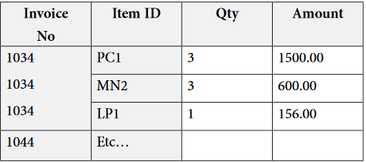
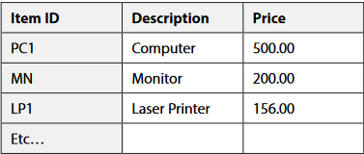
Detailed view
Note that there are now two foreign keys defined (Invoice_Noand Item_ID) and they would be used together to form a compound primary key in the new INVOICE_ITEM relation. If the 2NF relations were implemented as tables, the INVOICE table would remain unchanged and the INVOICE_ITEM table would now have fewer columns than before:
There would also be a new table which would be named PRODUCT:

Slide 30
Good news!
The advantage of having data in 2NF is that redundancy has been removed.
In 1NF for instance, you would have had to provide the value for the attribute “Description” in the INVOICE_ITEM table every time a new invoice was produced which had that particular product on it.
In 2NF the value is provided once only in the PRODUCT table.

Slide 31
Exercise
a) Check the two relations resulting from the conversion to 1NF in Exercise 2.
b) Does one or both need converting?
c) Convert the data into 2NF by following the appropriate steps

Slide 32
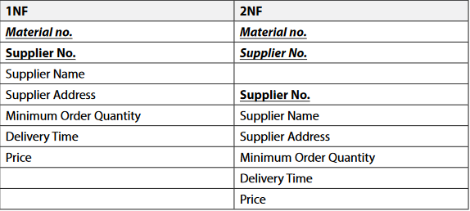
Feedback
a), b) and c) Only the following 1NF table needs to be checked for 2NF as it has a compound primary key. This results in two tables at 2NF.
Notice that in 2NF the original 1NF Material relation only consists of the compound primary key, and the Supplier No. is now acting as a foreign key to the new SUPPLIER details relation.

Slide 33
Third Normal Form (3NF)
A relation is in Third Normal Form if -
-it is already in 2NF
-there are no functional dependencies between any pair of non-key attributes (i.e. there are no transitive dependencies)
If an attribute is functionally dependent on another attribute, that one is referred to as the determinant.
For example:
Is Invoice No. a determinant of Invoice Name? Yes
Is Invoice Name a determinant of Invoice_No.? No
If an attribute is the determinant of a second attribute and that attribute is the determinant of a third attribute then the third attribute is transitively dependent on the first attribute.

Slide 34
Conversion to 3NF
Converting the data tables to the third normal form will further improve the logical design of the database.
This is a very similar process to the one for 2NF. To do this, follow the steps below:
1. Identify any attributes that are determined by another non-key attribute
2. Remove these attributes to a new relation
3. Set the non-key attribute to be the Primary key in the new relation
4. Convert the non-key attribute to a foreign key in the original relation.

Slide 35
Overview
The Third Normal Form is very similar to the Second Normal Form.
However, instead of considering whether some attributes in the table are dependent on only part of a compound key, a check is made to see whether they are dependent on attributes which are not part of the key.
In a very similar way to 2NF, you remove the attributes which depend on this (non-key) attribute into a new table

Slide 36
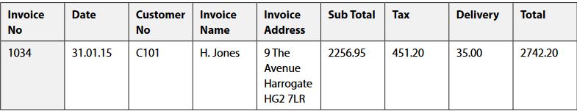
Example
As an example of a table being in 2NF but not in 3NF, consider the INVOICE relation:
If you look carefully at this relation you will see that there is a functional dependency between the non-key attributes Invoice Name and Invoice Address. Invoice address is actually dependent on (or determined by) the Invoice Name, not by the Invoice No. The Invoice Address is said to be transitively dependent on the Invoice No.

Slide 37
Dependancy
This is not an ideal situation as every time an invoice for a customer was produced, the customer’s address would be duplicated.
By converting to 3NF the Invoice Name and Address attributes are removed to a new relation, and the Invoice Name would become the primary key of the new relation.
The Invoice Name would remain in the existing table but would now be acting as a foreign key. The relations are now in 3NF and so you can say they have been ‘normalised’, thus providing you with a set of efficient table structures which can now be considered for use in the physical design stage. The completed template below shows all the relations and their names.

Slide 38
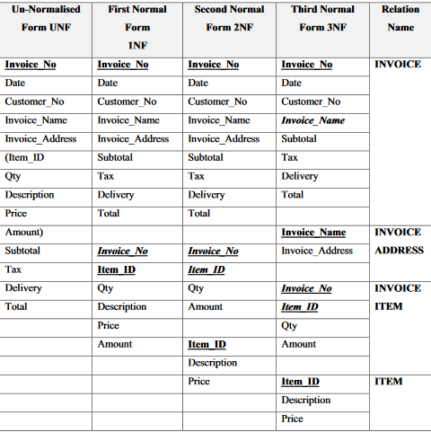

Slide 39

ERD for the Invoice

Slide 40
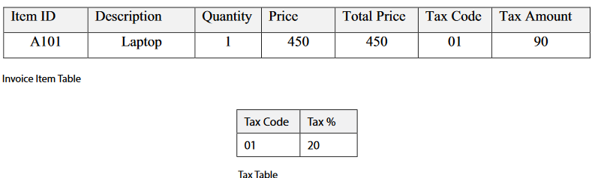
Denormalisation
Although you should always aim to implement a normalised set of tables where possible, there are occasions when you might conside denormalising, usually for performance reasons.
Ex.:
Denormalisation could be applied to speed up the calculation.

Slide 41
Checking the model & Summary
Before moving on to the development phase it is important to check that the normalised set of relations will support the business transactions that are required for the database system.
This is usually achieved by taking each transaction or search query and tracing the pathways from entity to entity on the composite
ERD in order to ensure that it is possible to link to the relevant entities and extract the relevant attributes to satisfy the query.
Summary
The relations of the logical design can be improved in terms of reduction of wasted space and elimination of redundancy by the process of normalisation.
Relations derived from ERDs may well be already normalised, but ones derived from other sources, e.g. forms or reports, will probably not be.

Slide 42
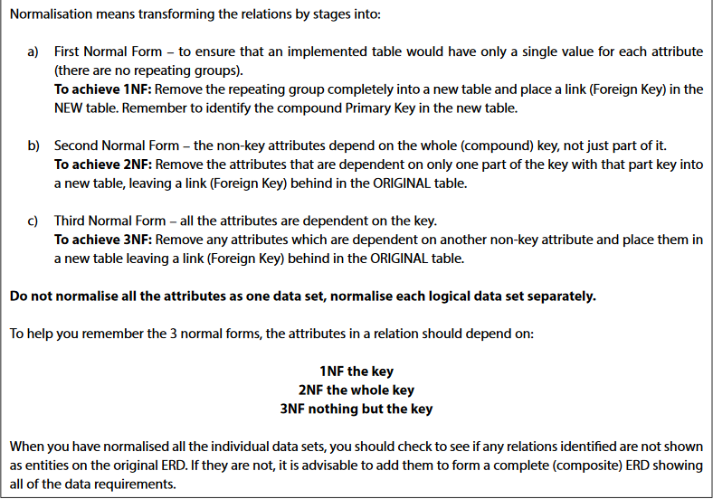

Slide 43
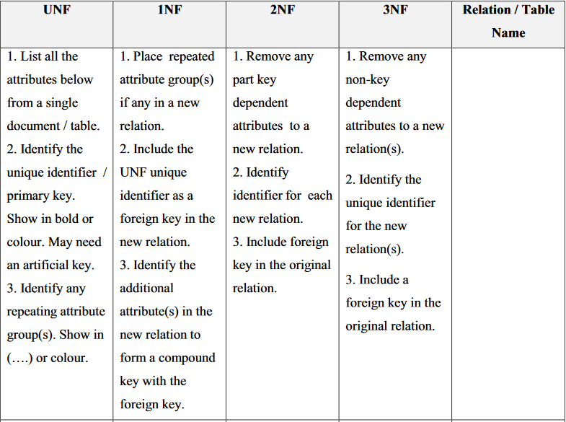
Normalisation Template

Slide 44
Exercise
For each of the following statements decide which of the three normal forms would be applicable.
The non-key attributes depend on the whole (compound) key, not just part of it.
2. For each row of the table, there is a single entry in each column.
3. In a table in this form all non-key attributes are fully functionally dependent on the key.
Second Normal Form
First Normal Form
Third Normal Form

Slide 45
Additional information

Slide 46
Normalization Rule (more updated)
Normalization rules are divided into the following normal forms:
First Normal Form
Second Normal Form
Third Normal Form
BCNF
Fourth Normal Form

Slide 47
Boyce-Codd Normal Form (BCNF)
Boyce-Codd Normal Form or BCNF is an extension to the third normal form, and is also known as 3.5 Normal Form.
TWO CONDITIONS:
It should be in 3NF;
For any dependency A B, A should be a super key. (A cannot be a non-prime attribute, if B is a prime attribute.)

Slide 48
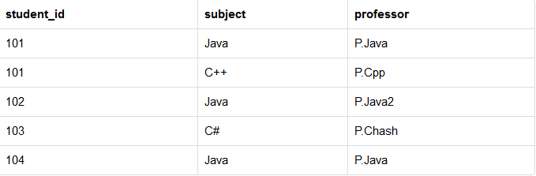
Example
Primary key
Another dependency
One student can enrol for multiple subjects. For example, student with student_id 101, has opted for subjects - Java & C++
For each subject, a professor is assigned to the student.
And, there can be multiple professors teaching one subject like we have for Java.

Slide 49
Example (continue)
This table satisfies the 1st Normal form because all the values are atomic, column names are unique and all the values stored in a particular column are of same domain.
This table also satisfies the 2nd Normal Form as their is no Partial Dependency.(no embaded tables)
And, there is no Transitive Dependency, hence the table also satisfies the 3rd Normal Form.
But this table is not in Boyce-Codd Normal Form

Slide 50
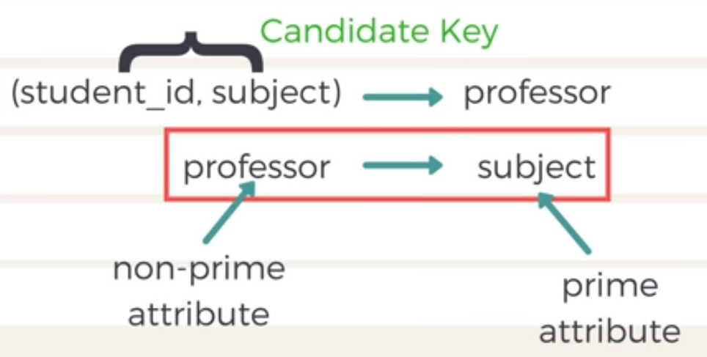
Example (Why this table is not in BCNF?)

Slide 51
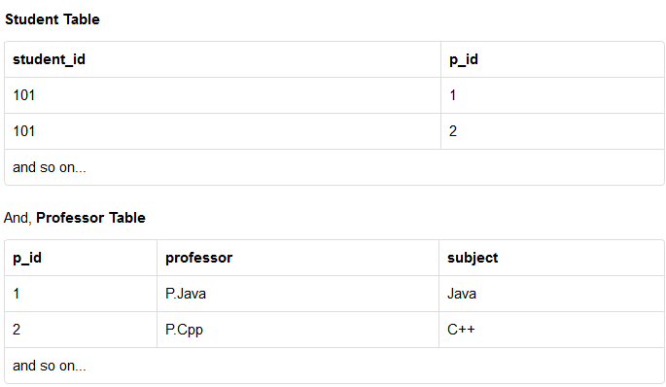
Example (How to satisfy BCNF?)
To make this relation(table) satisfy BCNF, we will decompose this table into two tables, student table and professor table

Slide 52
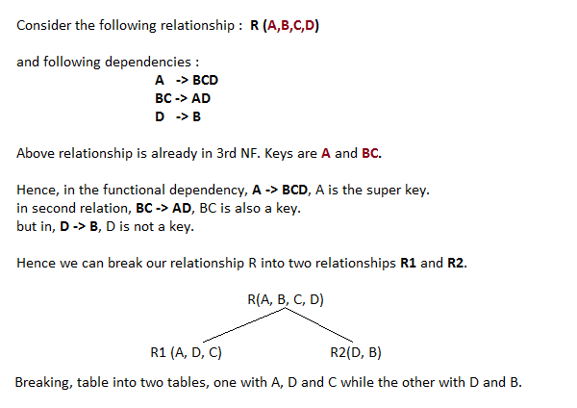
A more Generic Explanation
In the picture below, we have tried to explain BCNF in terms of relations.

Slide 53
Fourth Normal Form (4NF)
Fourth Normal Form comes into picture when Multi-valued Dependency occur in any relation.
For a table to satisfy the Fourth Normal Form, it should satisfy the following two conditions:
It should be in the Boyce-Codd Normal Form.
And, the table should not have any Multi-valued Dependency.

Slide 54
What is Multi-valued Dependency?
A table is said to have multi-valued dependency, if the following conditions are true,
For a dependency A → B, if for a single value of A, multiple value of B exists, then the table may have multi-valued dependency.
Also, a table should have at-least 3 columns for it to have a multi-valued dependency.
And, for a relation R(A,B,C), if there is a multi-valued dependency between, A and B, then B and C should be independent of each other.
If all these conditions are true for any relation(table), it is said to have multi-valued dependency.

Slide 55
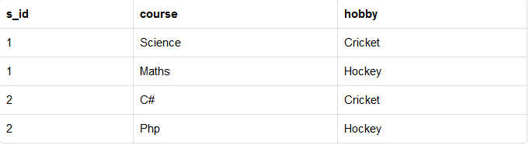
Example
s_id 1 has opted for two courses, Science and Maths, and has two hobbies, Cricket and Hockey.

Slide 56
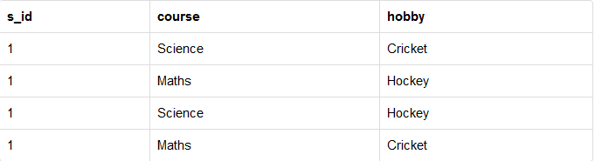
Example (continue)
You must be thinking what problem this can lead to, right?
Well the two records for student with s_id 1, will give rise to two more records, as shown below, because for one student, two hobbies exists, hence along with both the courses, these hobbies should be specified.
There is no relationship between the columns course and hobby. They are independent of each other.
So there is multi-value dependency, which leads to un-necessary repetition of data and other anomalies as well.

Slide 57
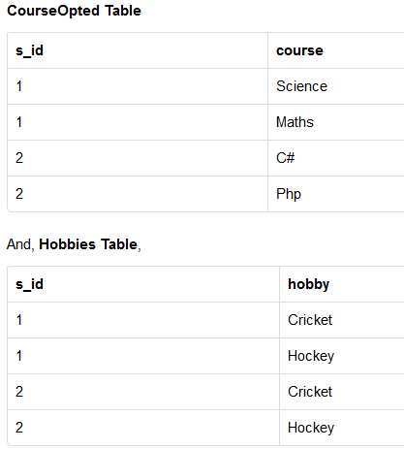
How to satisfy 4th Normal Form?
Now this relation satisfies the fourth normal form.
A table can also have functional dependency along with multi-valued dependency.
In that case, the functionally dependent columns are moved in a separate table and the multi-valued dependent columns are moved to separate tables.
If you design your database carefully, you can easily avoid these issues.

